Slide 1

MTBI Personality Predictor using ML
Salman Ahmed
Andy Sin
Ashrarul Haq Sifat
Instructor: Dr. Bert Huang
Virginia Tech
12/13/2017

Slide 2
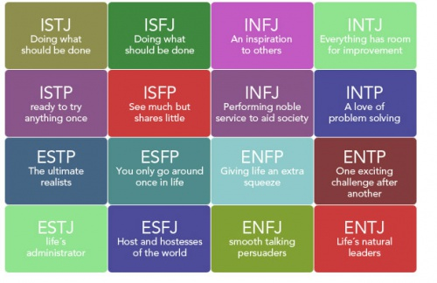
What is MBTI
Myers-Briggs Type Indicator

Slide 3
Motivation
freeform writing: a great degree of personal expression
Neuro-scientific background
Application in research, business, fun, and many more

Slide 4
Objectives
Identify a correlation between writing styles and psychological personalities
Evaluate accuracy of MTBI predictor
Convert textual representation of freeform writing into feature representation
Explore the state-of-the-arts techniques for this prediction task
Express the necessity of fancy machine learning models (RNN, ConvNets, CNNs, etc.) in this area

Slide 5
Prior Work
Big Five Personality Inventory
Web crawlers to collect data
SVM model
Estimation accuracy 80%
MBTI
close relation of brain neurons to written communication
short-term memory based recurrent neural network
37% accuracy

Slide 6
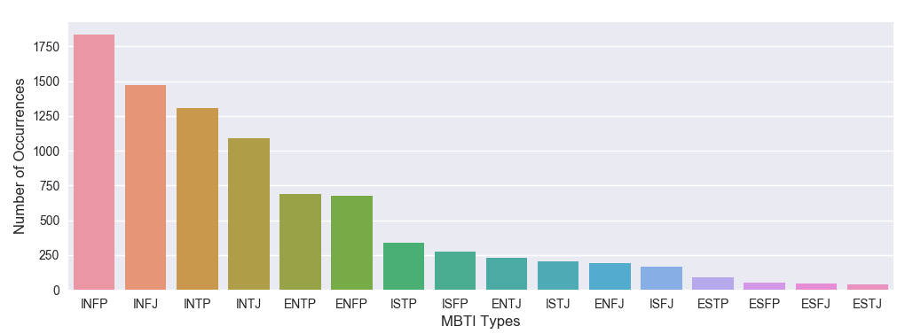
Dataset
MBTI Dataset from kaggle
Not balanced: possibility of biasness
8765 examples
1500 words in each

Slide 7
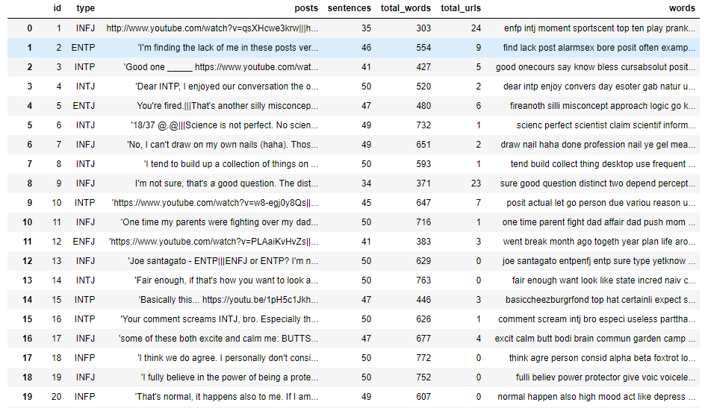
Data Cleaning

Slide 8
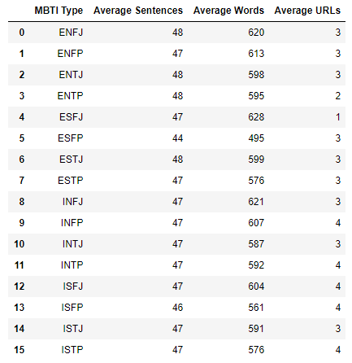

Slide 9
Traditional Model
Naïve Bayes – count method
tried this method to see the learning works for a basic model
Multi-Layer Perceptron - Vector representation
Genism Word2Vec embeddings
Turn each example into a 32-dimensional vector
matrix of 8675 x 32 dimension

Slide 10
Improved Model
Principle Component Analysis
CountVectorizer
maximum number of features : 5000
normalized TF or TF-IDF representation

Slide 11
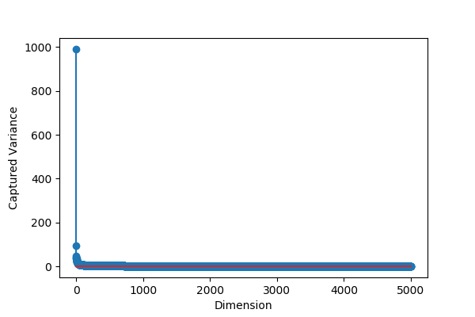

Slide 12
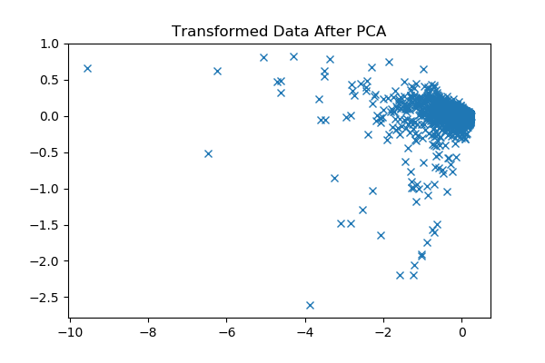
Axis:

Slide 13
Multinomial Naive Bayes with TF-IDF and Count Vectorizer
Logistic Regression with TF-IDF and Count Vectorizer
Multi-Layer Perceptron with TF-IDF and Count Vectorizer

Slide 14
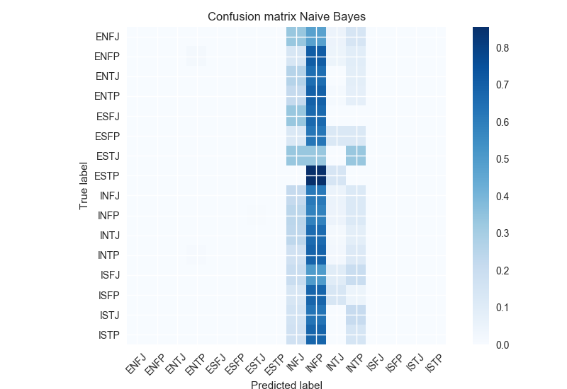
Results
The Naïve Bayes : 19% accuracy

Slide 15

MLP (basic counting) : 22% accuracy

Slide 16
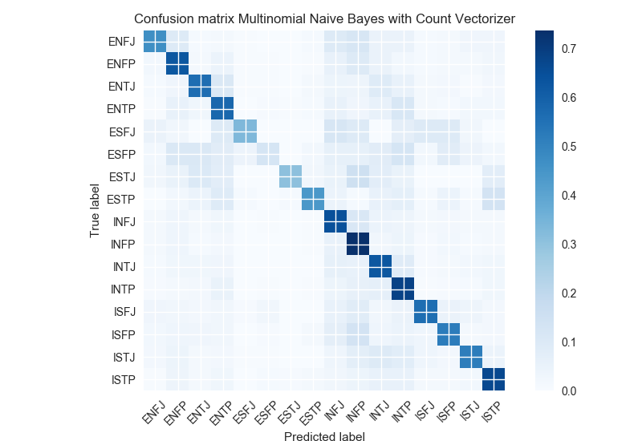
Multinomial Naïve Bayes: 53% accuracy

Slide 17

Logistic Regression : 64% accuracy

Slide 18
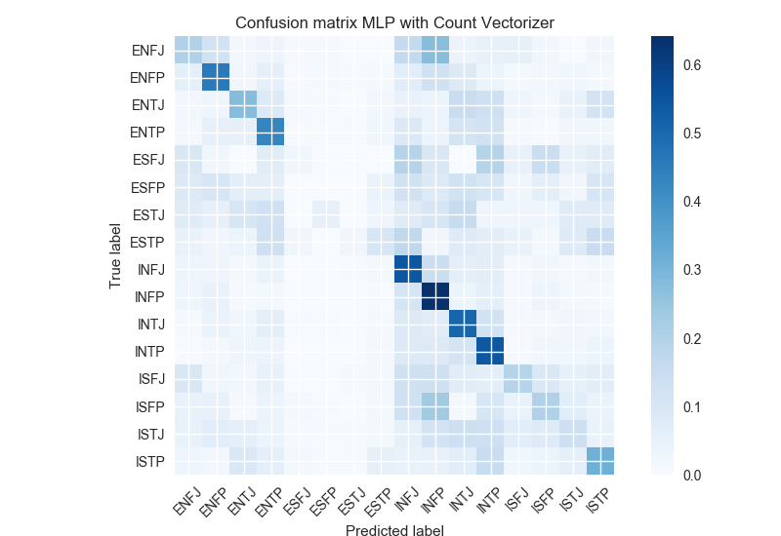
MLP : 48% accuracy

Slide 19
Comparison of Models
Model name | Accuracy
Naïve Bayes (basic counting) | 19%
Multilayer Perceptron (Word to Vector) | 22%
Multinomial Naïve Bayes (Count Vectorizer and TF-IDF Similarity) | 53%
Logistic Regression (Count Vectorizer and TF-IDF Similarity) | 64%
Multilayer Perceptron (Count Vectorizer and TF-IDF Similarity) | 48%

Slide 20
Summary

Slide 21
Conclusion

